Slide 1
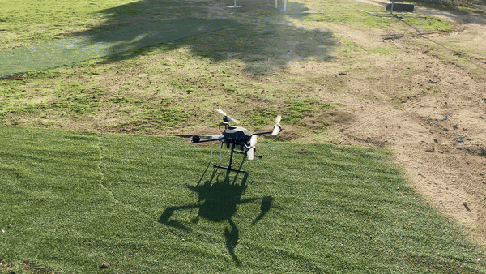
Applications of Autonomous Drones for Non-Terrestrial Networks in Remote Areas
By: Andrés Navarro Pedregal
Tutor: José Alberto Hernandez Gutiérrez

Slide 2
Table of contents
01
02
03
04
05
06
Introduction & Objectives
Technical Details
Building the Drone
Building the System
Flight Tests
Conclusions

Slide 3
01
Introduction & Objectives

Slide 4
Project & Objectives
Study of UAVs for NTNs applications
Viability of UAVs for NTNs
Develop design, manual, etc.
Create a budget UAV for research
Human rescue tasks with ML and LLMs
Application of UAVs for remote areas
6G Integration 3 & Telematics Department
Part of a Research Project

Slide 5
02
Technical Details

Slide 6
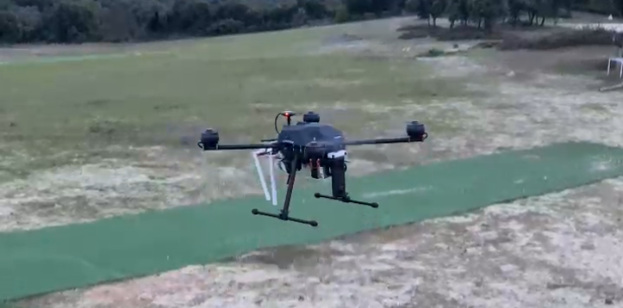
Characteristics
Weight: 6.5KG
Range: Up to 40Km
Flight time: 25-35 minutes
Autopilot capabilities
Retractable landing gear
ML & AI Intelligence

Slide 7
Main components
Frame | Tarot X690 | 17 inch propellers
Motors | T Motor U7 490kv | Up to 3kg per motor
Esc | TMotor Flame 70A LV
Flight controller | Pixhawk 6c | Using Ardupilot
GPS | Holybro M9N | 1.5m CEP precision
Battery | Tattu 4s 22Ah
Radio link | RFD868x | With mavlink telemetry
Controller | Radiomaster TX16S MAX

Slide 8
5G NTN Components
Onboard Computer | Jetson Orin Nano | 8GB RAM 5.3 FP32 TFLOPs
360 camera | Ricoh Theta X | 4K 30fps usb stream
4G/5G router | (GL-X750V2) Smart WiFi | Dual band, OpenWrt

Slide 9
03
Building the Drone

Slide 10
Drone Architecture
360 Camera
Onboard
computer
5G Router
PDB
Battery
Telemetry Control
Motors
ESC
Flight Controller
GPS

Slide 11
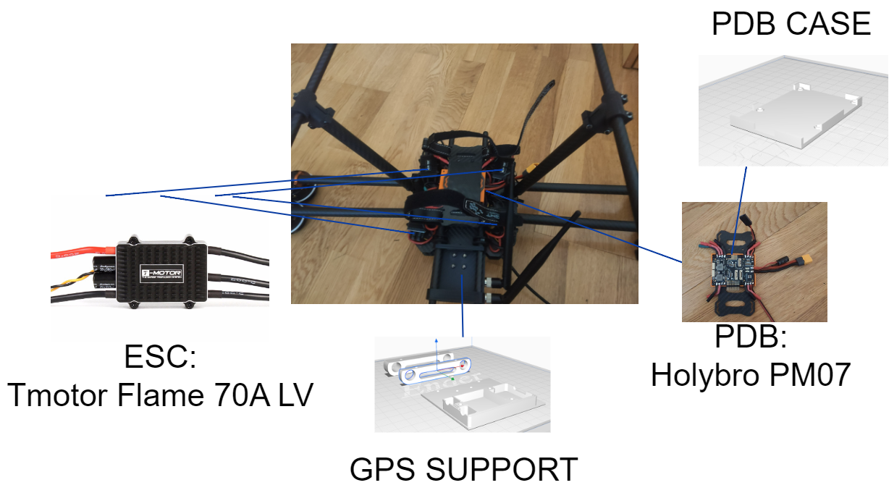
Component placement

Slide 12
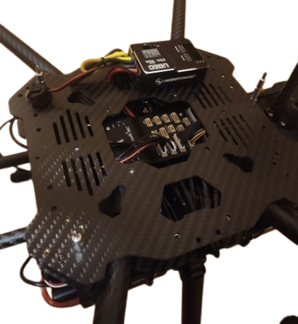
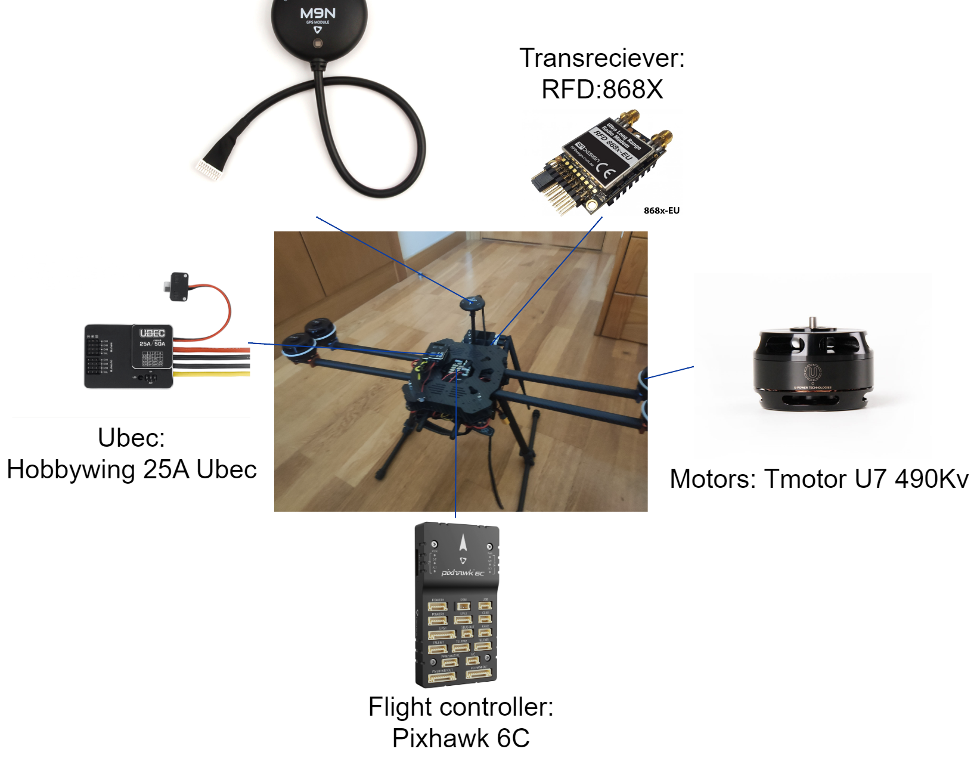
Component placement

Slide 13
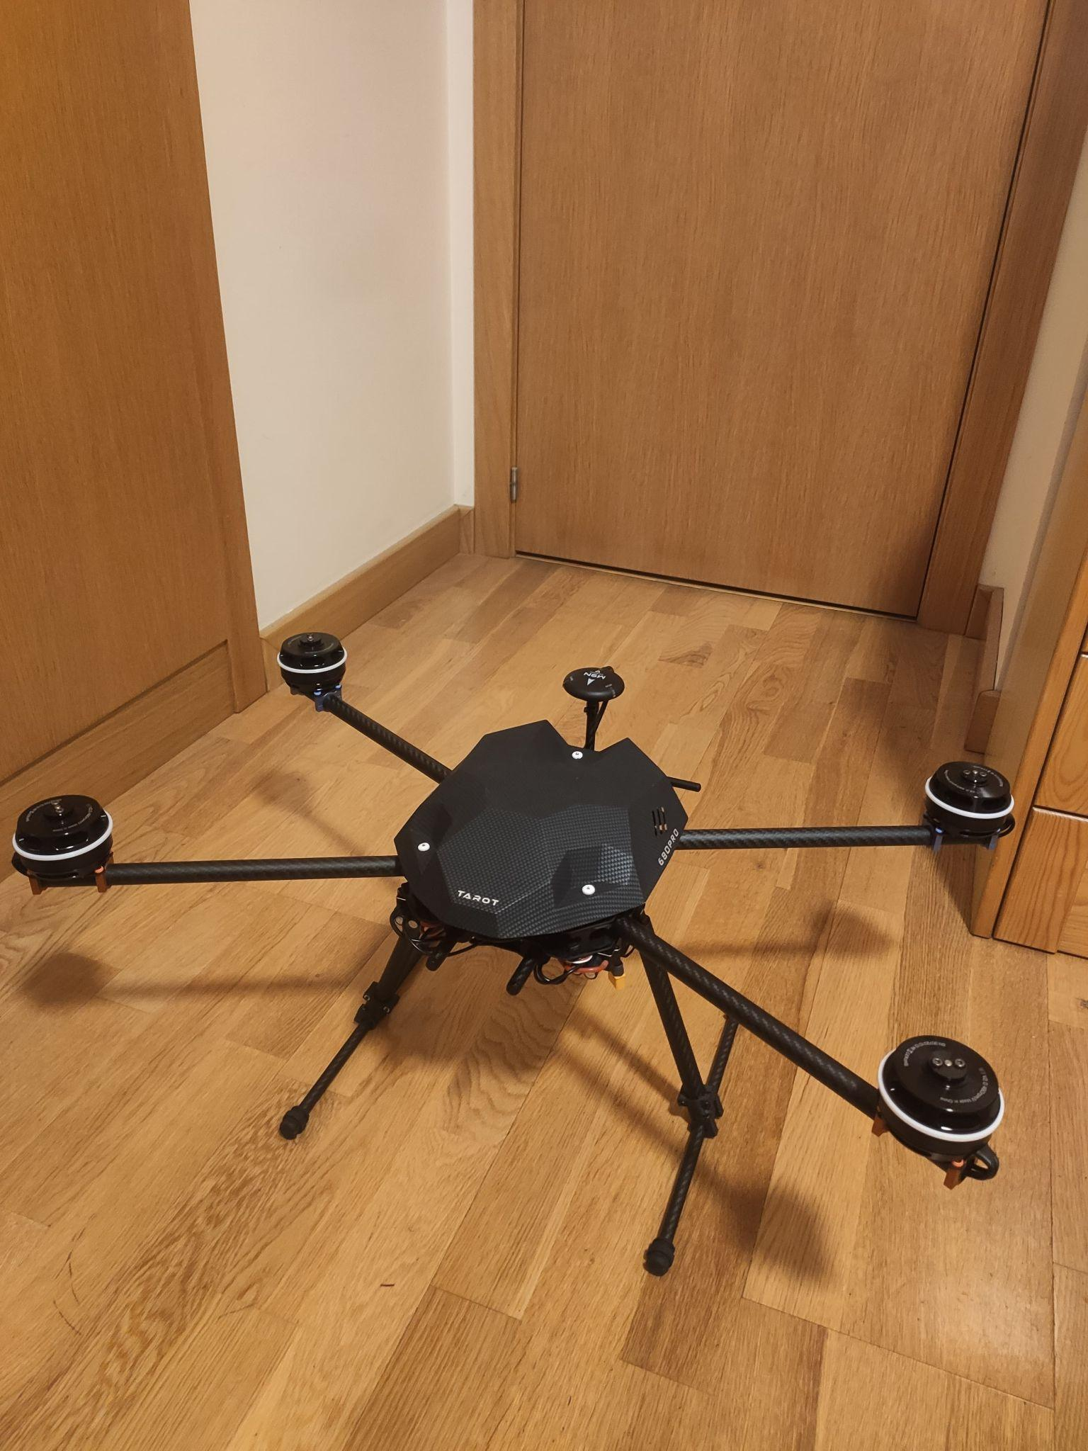
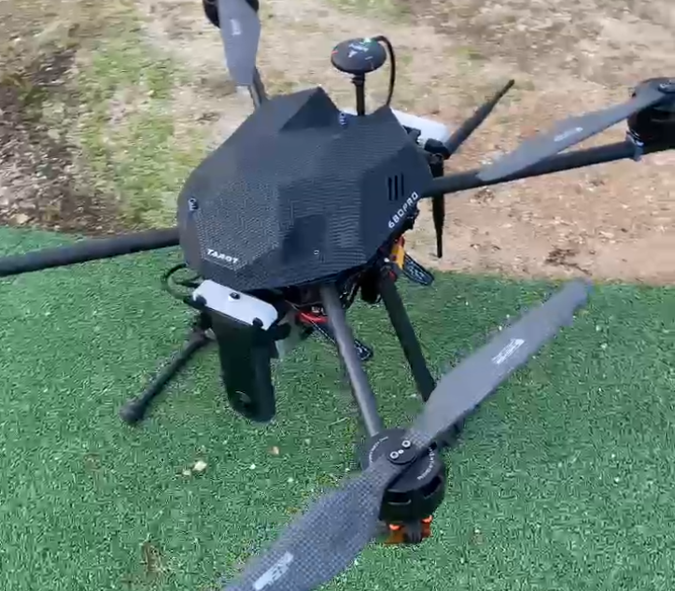
Full Build

Slide 14
04
Building the System

Slide 15
Steps
💻 Edge Computing
🧍 Detect People
🚨 Monitor Alerts
🤖 LLM Integration

Slide 16
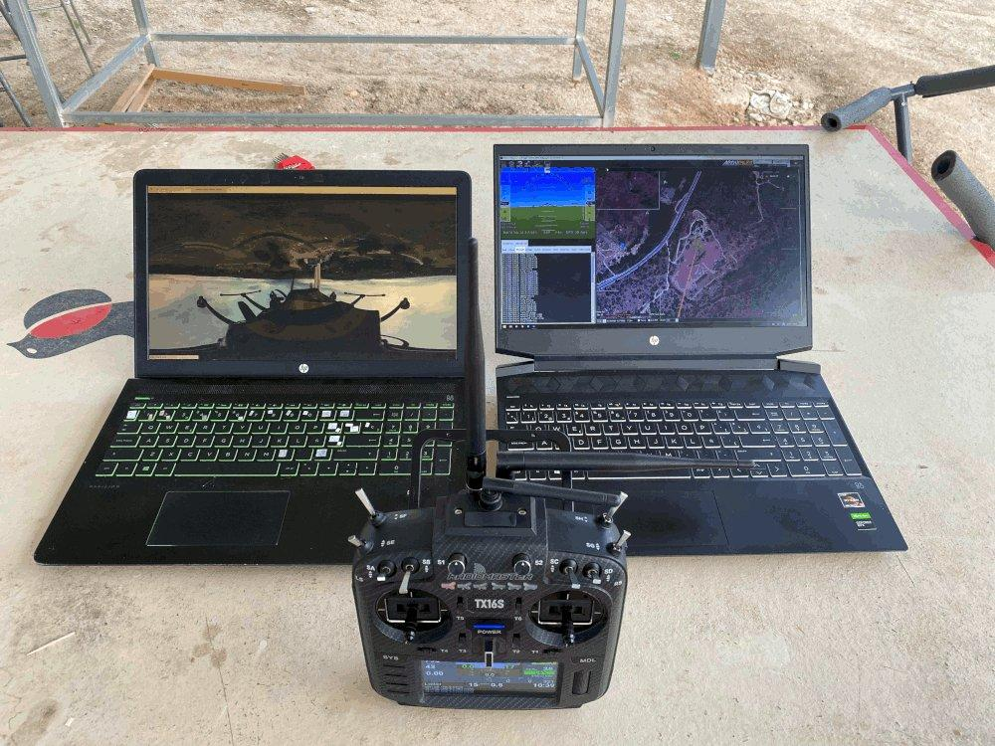
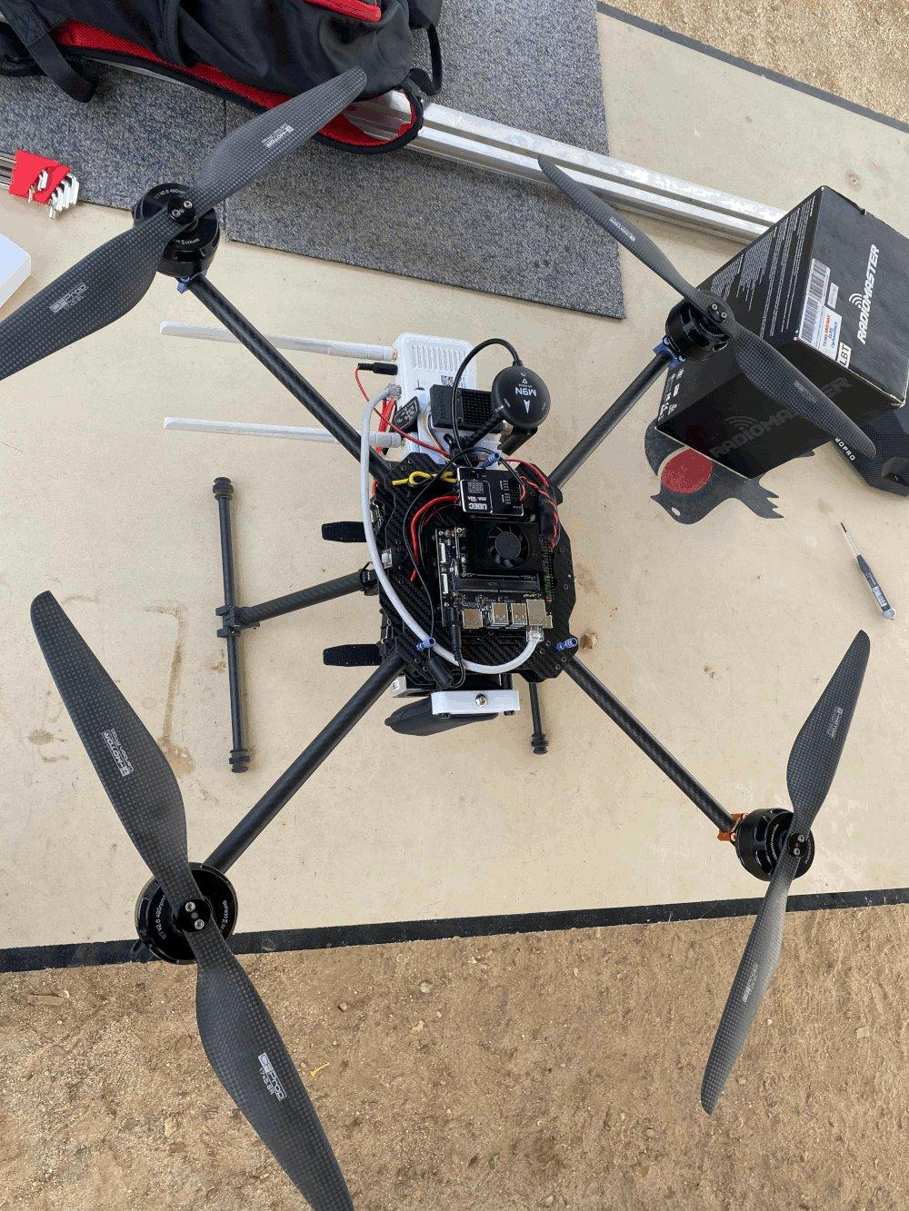

High Level Overview
Server & Ground Station
LLMs
Drone

Slide 17
Architecture
🔍
🚨
Object Detection
Alert
📷
💻
Server
360 camera
Object Detection
🤖
🌐
LLM Integration
Drone
VPN Tunnel

Slide 18
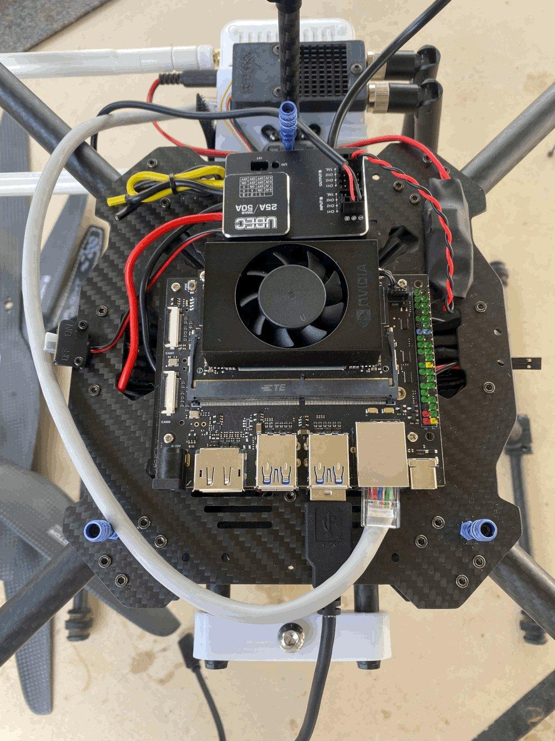
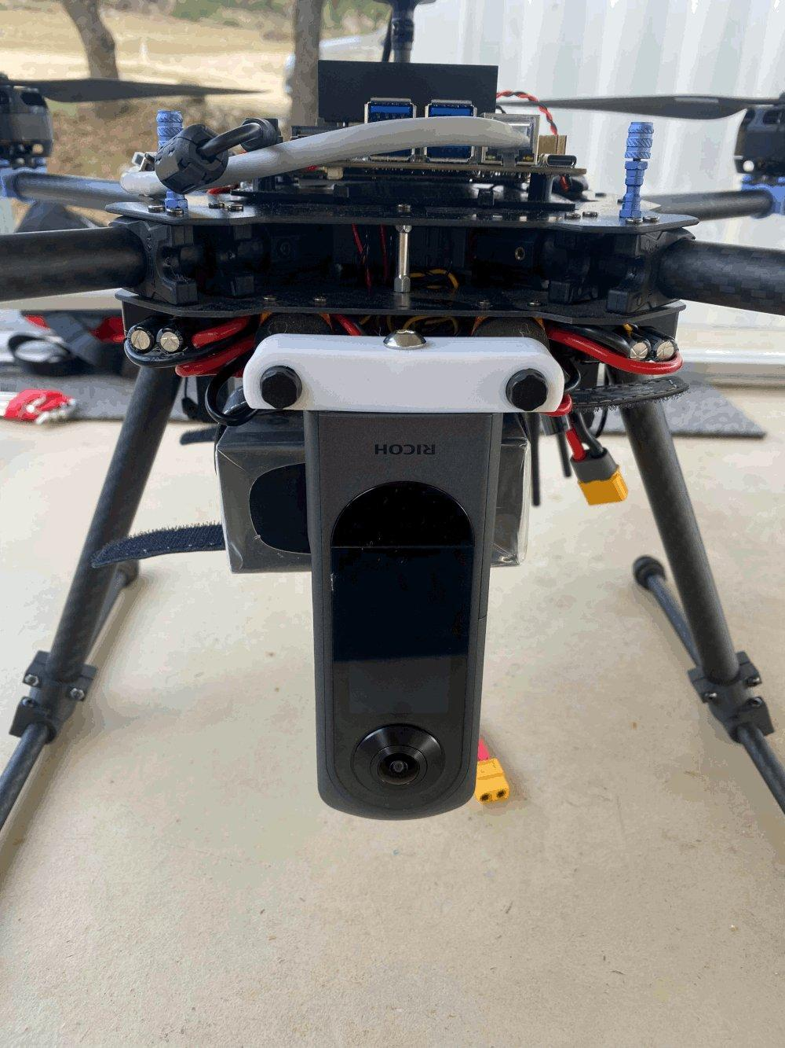
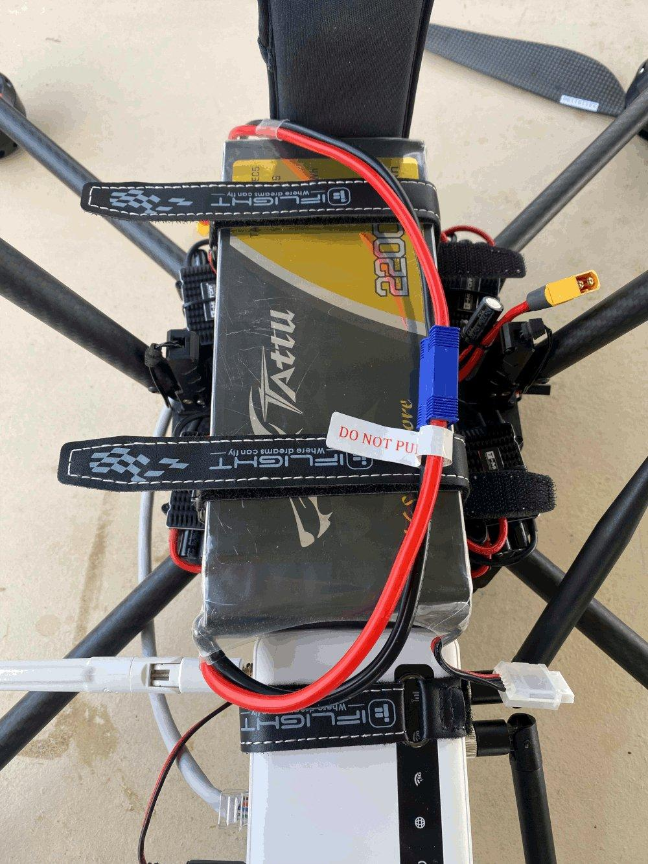
Drone
Edge Computer with GPU
360 Camera
Router

Slide 19
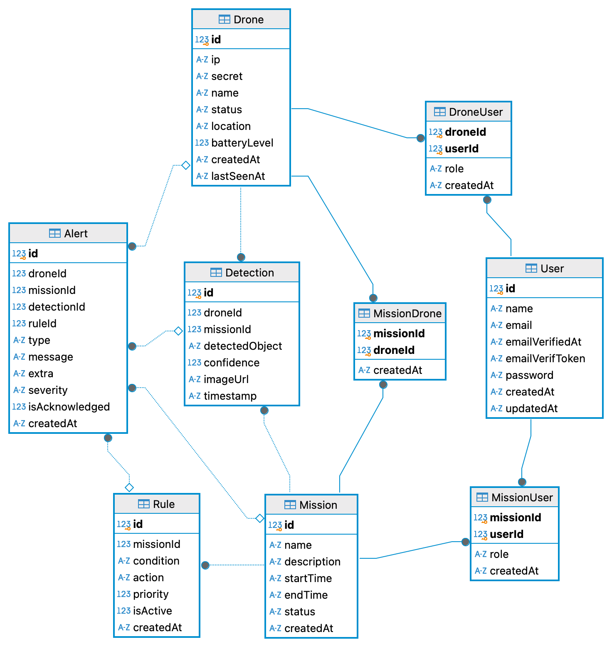
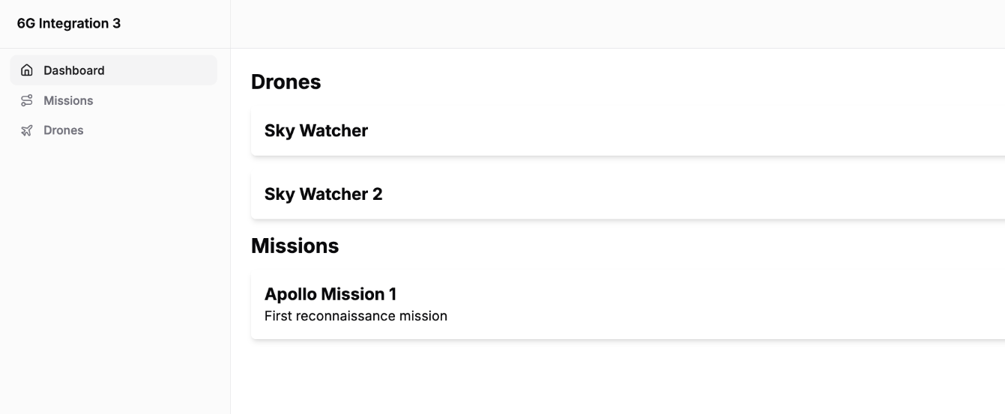
Server

Slide 20
DB Schema
📸
🚁
🚁
🚁
Detection
🚨
Drone
Alert
🟰
🗺️
🧍
🗺️
Rules
User
Mission

Slide 21
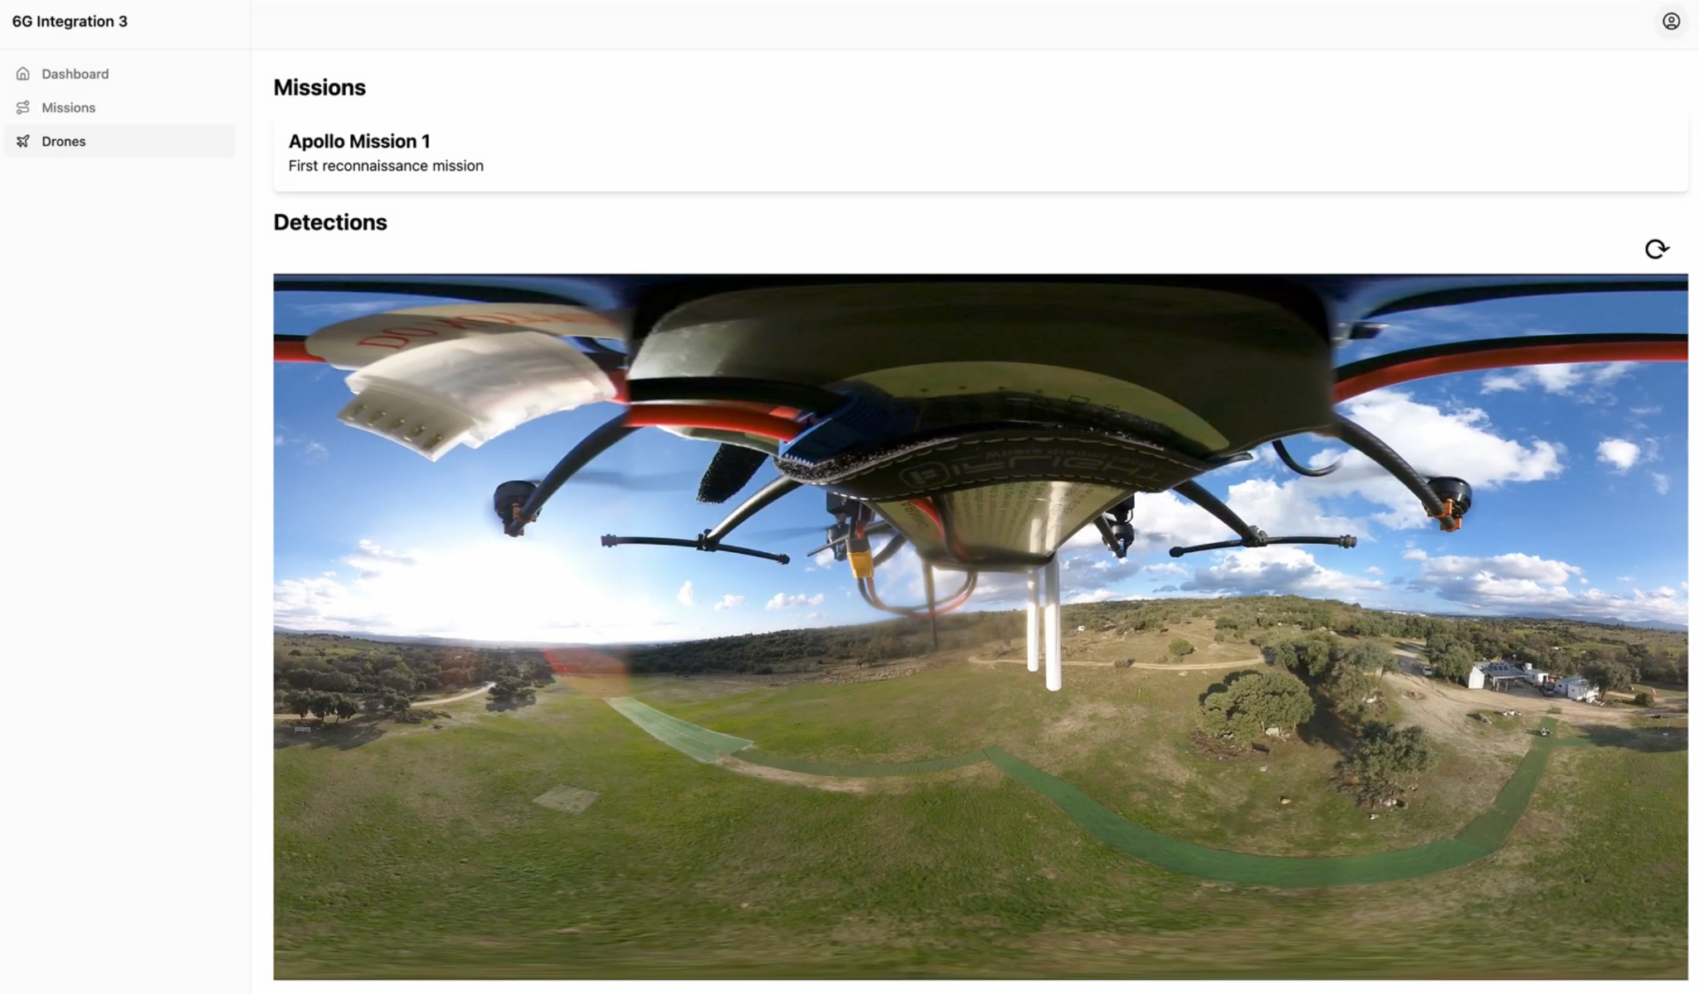
Live Connection of the Camera

Slide 22
05
Flight Tests

Slide 23
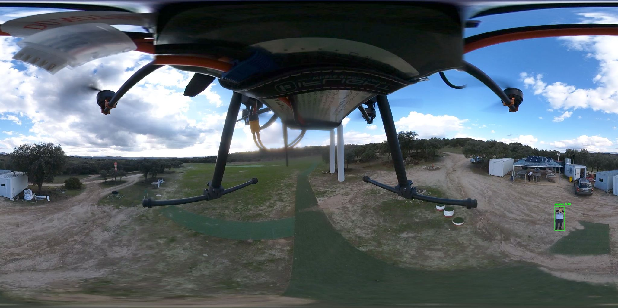
Detection Tests

Slide 24
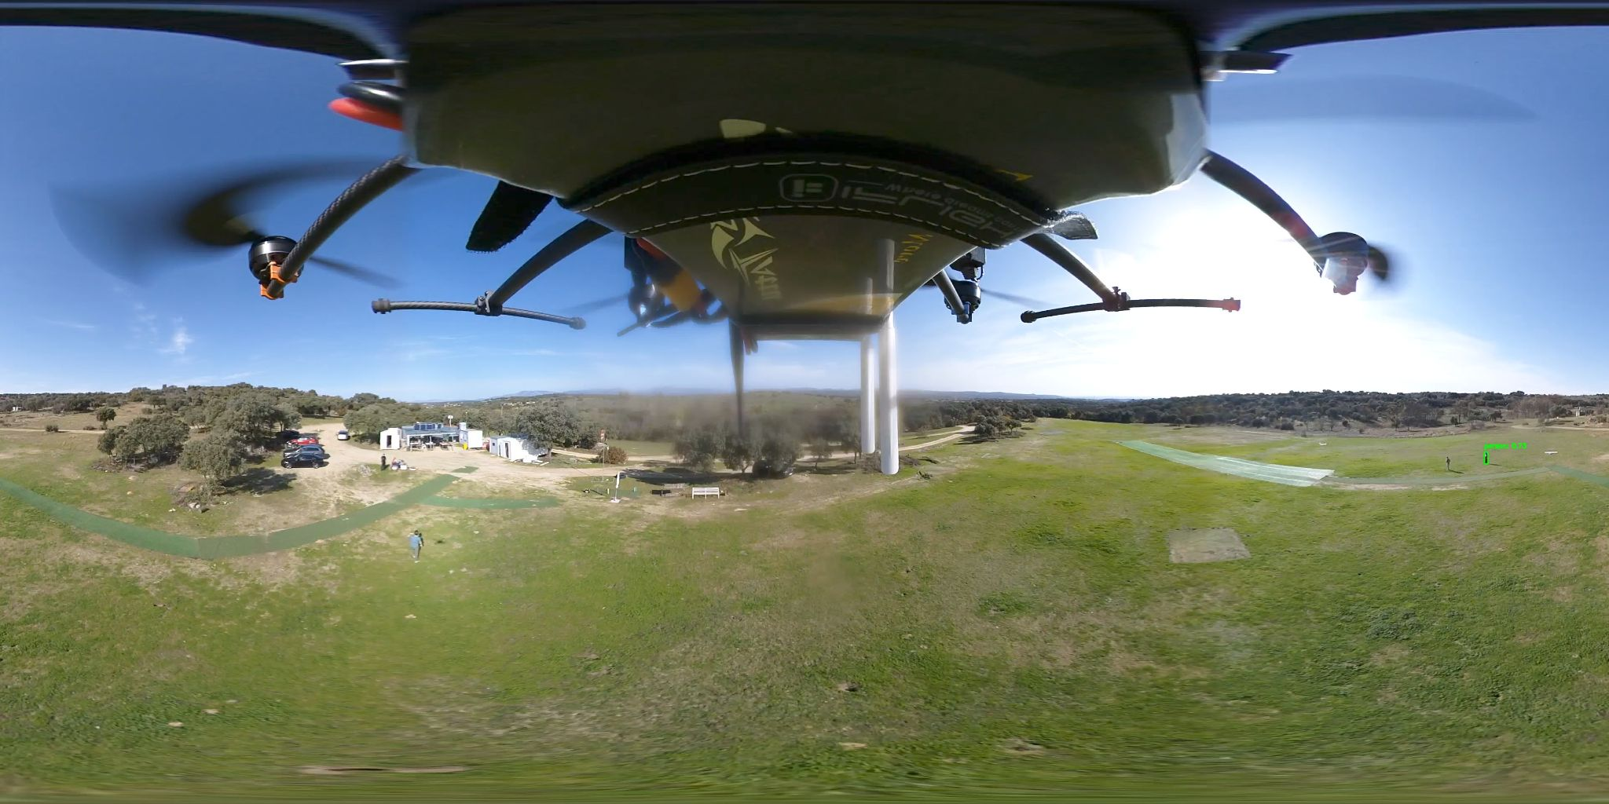
Detection Tests

Slide 25
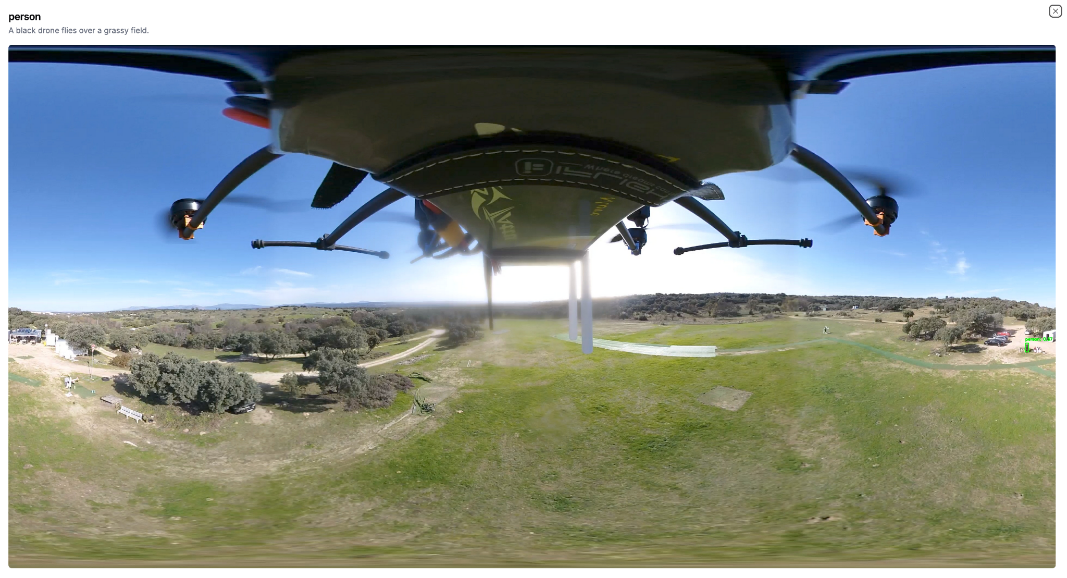
LLM functionality

Slide 26
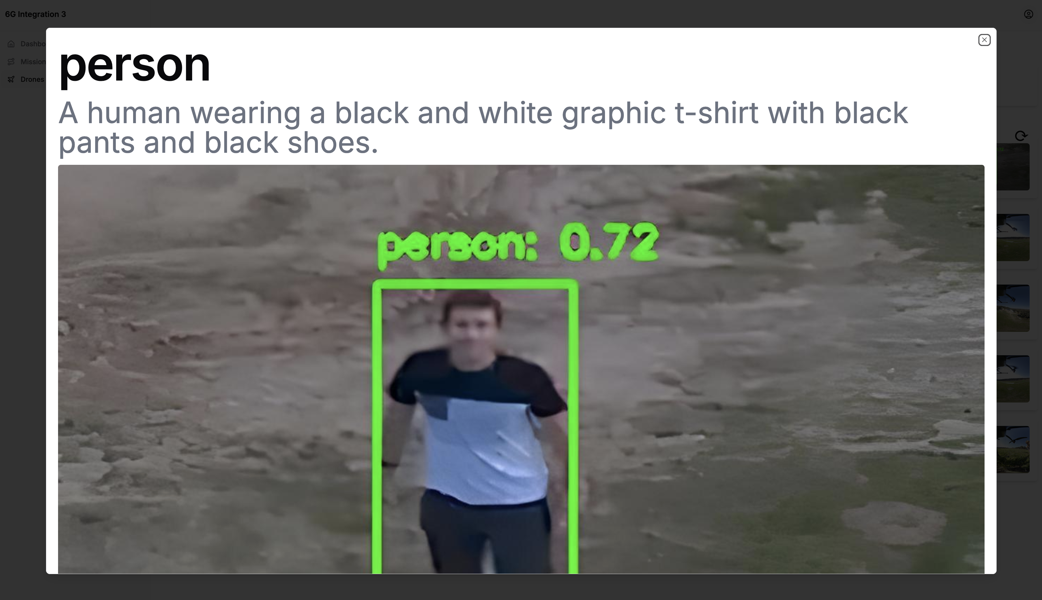

Slide 27
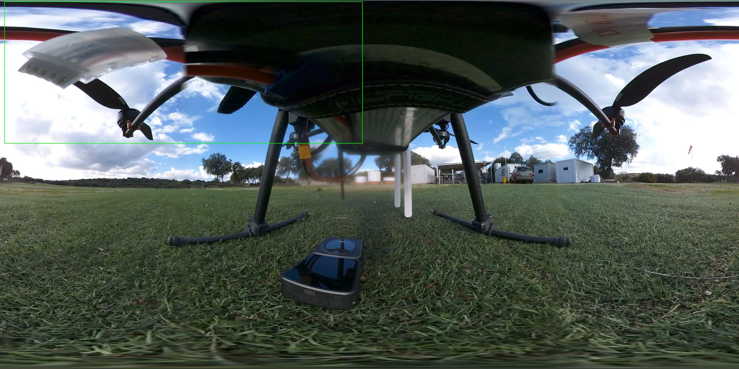
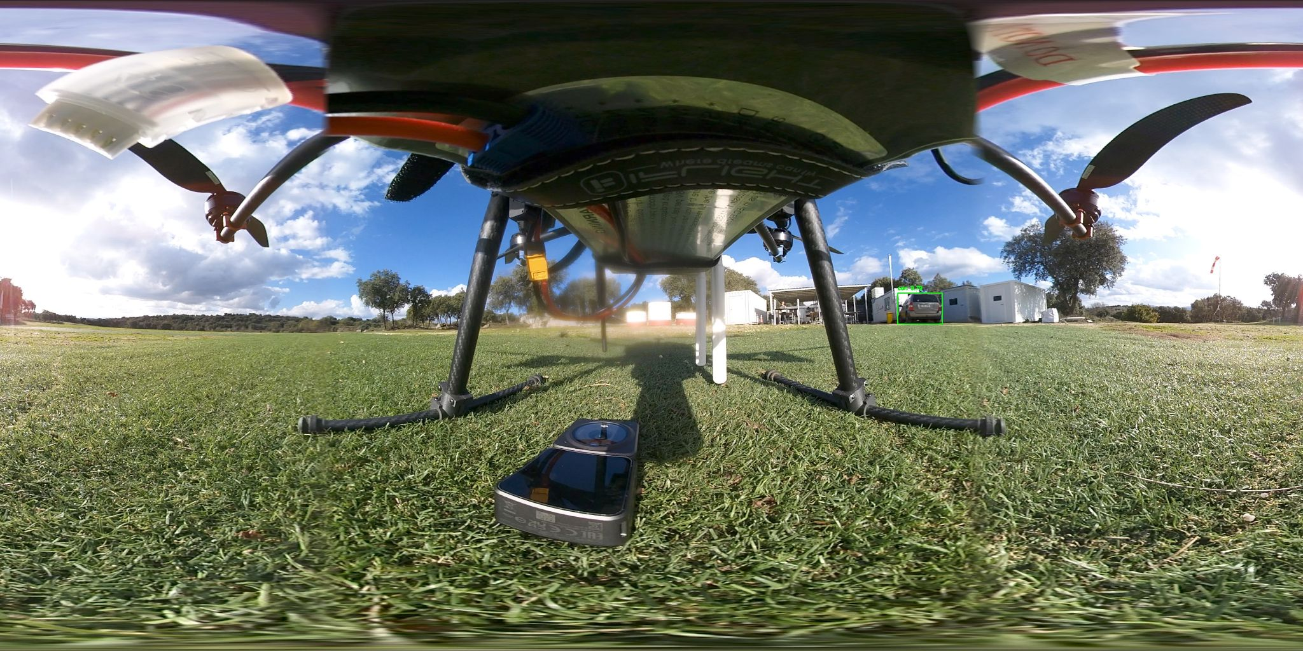
Random Detections

Slide 28
05
Conclusions

Slide 29
Flight Time: 30min
Detect Anything
Real Time Video Tx
Even the drone itself!

Slide 30
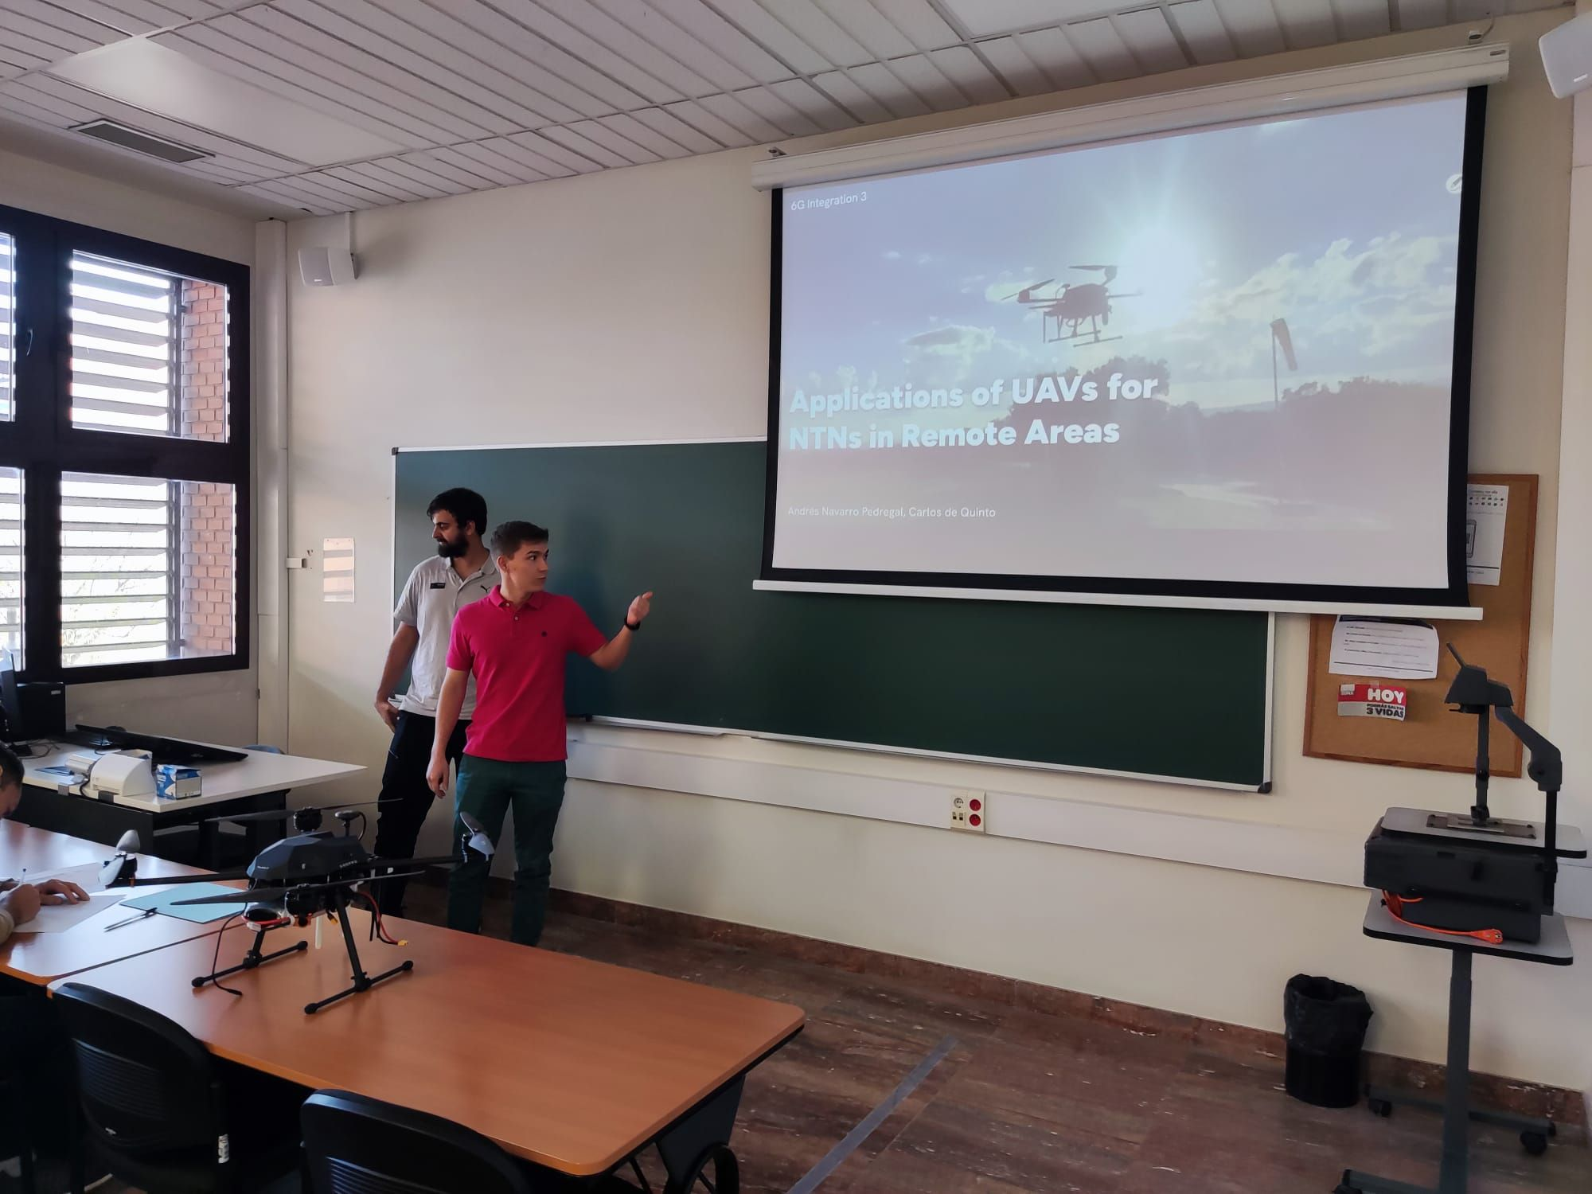
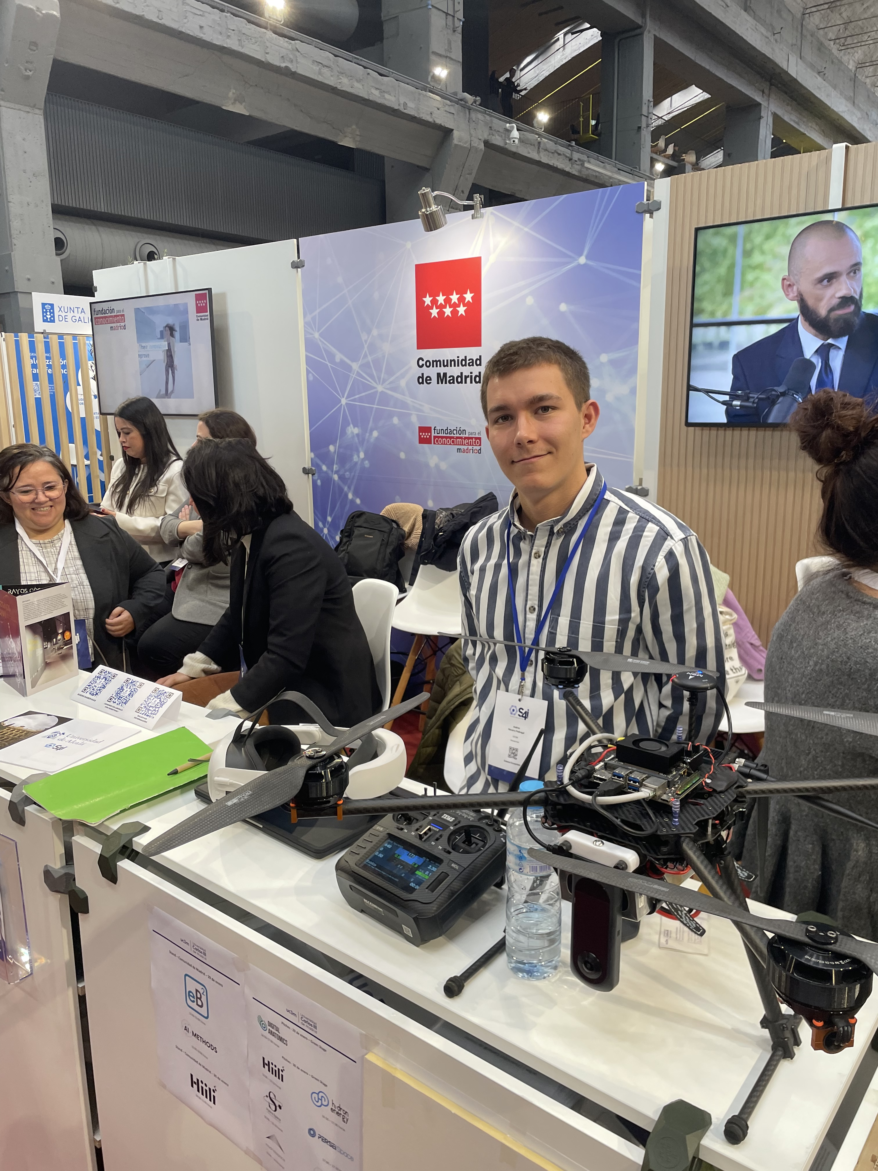

Showcase
6G Integration 3
Science for Industry (S4I) Conference
Part of a Paper
https://arxiv.org/abs/2409.19337

Slide 31
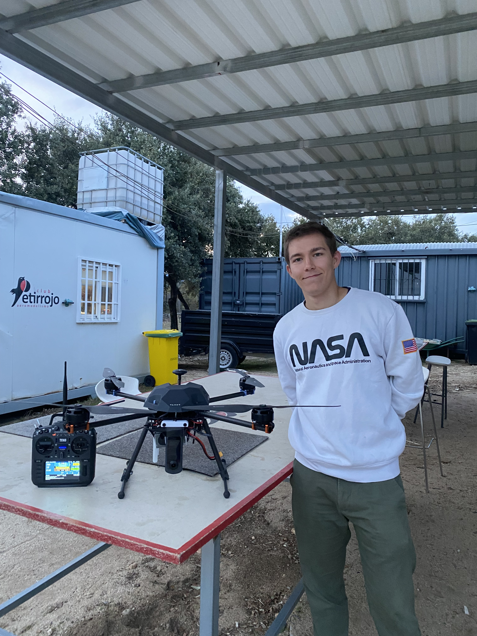
Thank you!
Any questions?

